Slide 1

Department of Electronics Engineering
Ramdeobaba University, Nagpur
Objectives
FloraSense
1
Develop an automated system for identifying plant species from leaf images.
Deep Learning-Based Plant Species Identification Using Leaf Images
2
Apply transfer learning using the MobileNetV3 deep learning architecture.
An intelligent system that uses deep learning to recognize plant species from images of their leaves, making identification faster, easier, and more accessible.
3
Classify leaf images into species and display the predicted class with its confidence score.
4
Provide a simple and user-friendly interface for plant identification.
Arnav Domalwar (13)
Anjali Balki (07)
Charul Bhanarkar (19)
Anushka Bhongade (10)
Guide: Dr. Snehal Laddha
Problem Statement: Manual plant identification requires botanical knowledge and can be time-consuming. FloraSense explores an automated, image-based approach to simplify this process.

Slide 2





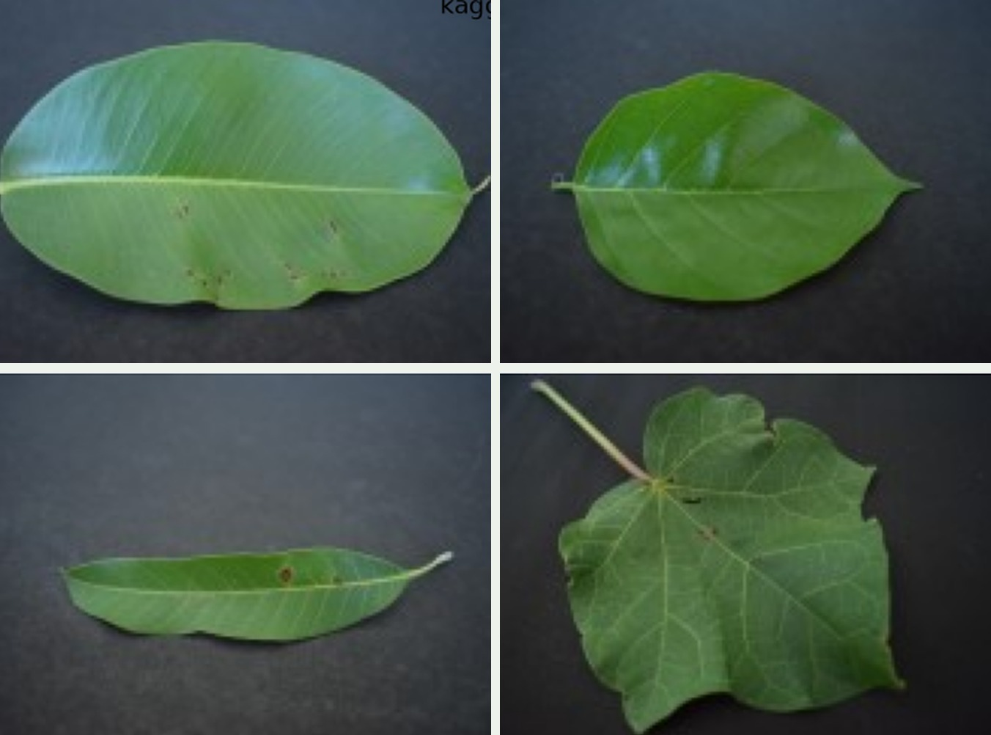
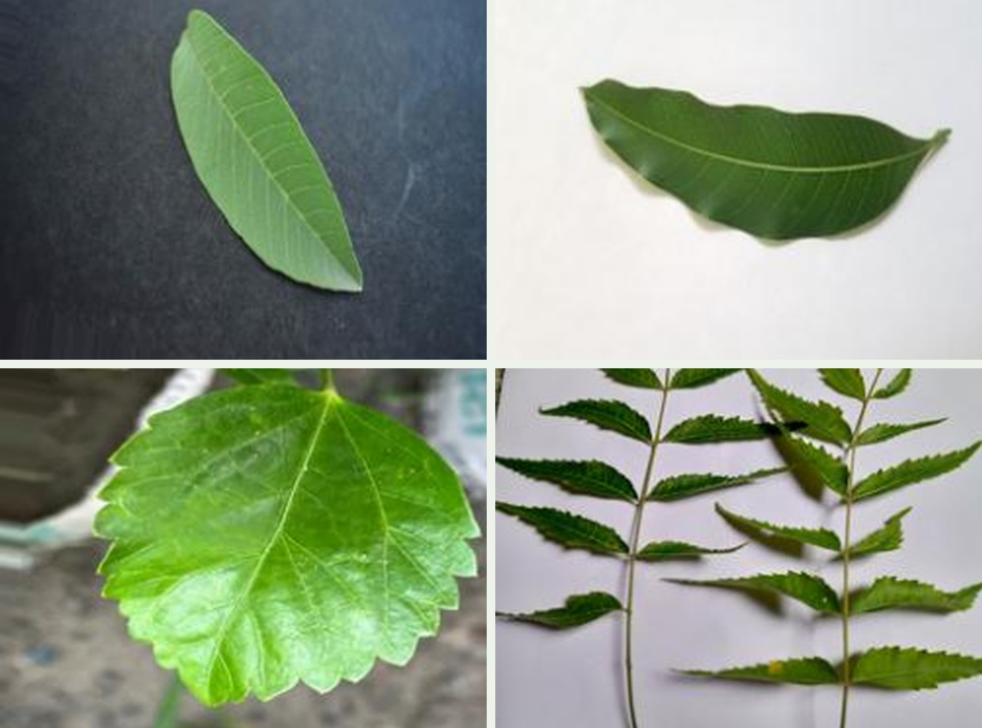
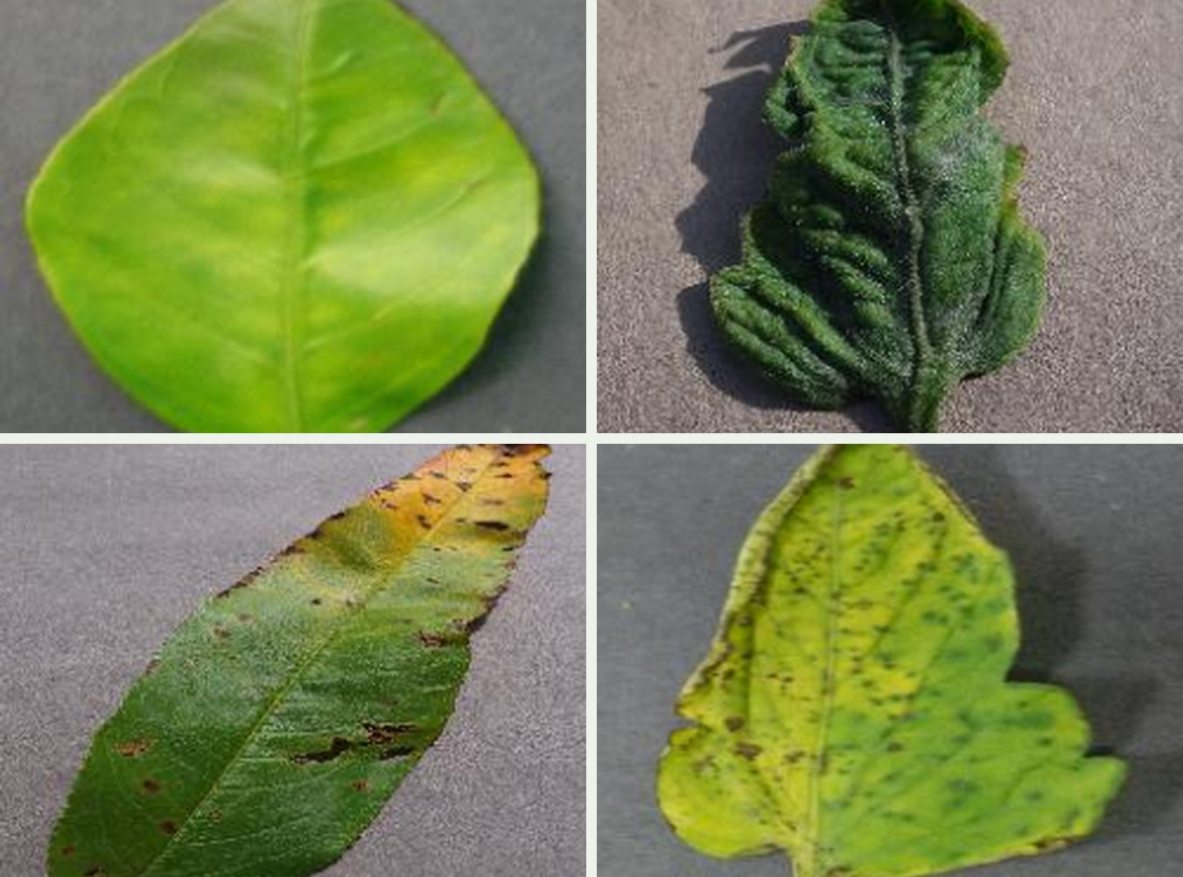
Methodology & Datasets
01
02
03
04
05
Data Collection
Preprocessing
Augmentation
Model Training
Evaluation
Leaf images of 12 species, plus campus photos for real-world checks.
Resize to 224 × 224, normalize pixels, split 70 / 15 / 15.
Random rotation and brightness changes on training images.
Fine-tune ImageNet-pretrained MobileNetV3 with Adam and cross-entropy loss.
Accuracy, macro-F1 and confusion matrix on the unseen test set.
Species Dataset
Campus Images
PlantVillage
Training & testing
Real-world validation
Health extension
12 leaf species on plain backgrounds
Varied backgrounds and lighting
Healthy and diseased leaves

Slide 3

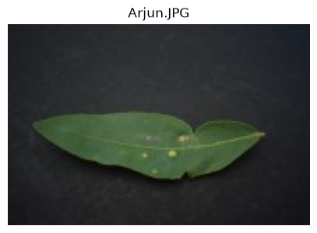



Demonstration & System Workflow
Upload Leaf Image
Sample input
The user selects or uploads an image of a plant leaf through the application interface.
Process & Predict
The image is resized and normalized, then passed to the trained MobileNetV3 model.
App screenshot
Predicted species and confidence
Arjun leaf photographed on a dark background.
Display Results
The app shows the predicted plant species along with its confidence score.
Upload image
Preprocess image
Run trained model
Display species and confidence
Notes:
Replace the dashed placeholder with a real screenshot of the FloraSense app showing a prediction and its confidence score.

Slide 4
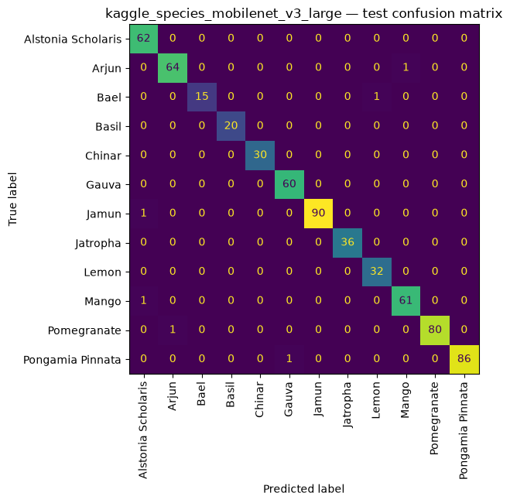
Results & Conclusion
99.1%
0.99
12
Test accuracy
Macro-F1 score
Species classes
Key Observations
636 of 642 test images were classified correctly.
Six of the 12 species reached 100% recall.
Each of the six errors is a single image, with no systematic confusion between species.
Conclusion: Transfer learning with a lightweight MobileNetV3 identifies leaf species reliably. Next: campus-photo validation, more species, and plant-health assessment.
Notes:
Accuracy (636/642) and macro-F1 (0.990) were computed directly from the test confusion matrix shown on this slide. Model size, FPS/latency and the ResNet18 comparison are not shown because measured values were not provided.

